Slide 1
Tablet
Beta Plan
Diogo, Lio, Ray, Jose, Sam and Cameron

Slide 2
Tablet Beta - Road Map
Alpha Review
Direct Improvements
Haptic Trade
Design Options
Notes:
Cam

Slide 3
Key Requirements & Scope
Continuous 6N at each end effector
Track fingers moving 150 mm/s
100 micron resolution of position at each end effector
User experiences 100 grams or less of inertia in free motion
Beta Focus
Prioritize the haptic experience of a single point on the touch screen before adding the capability of multi-touch.

Slide 4
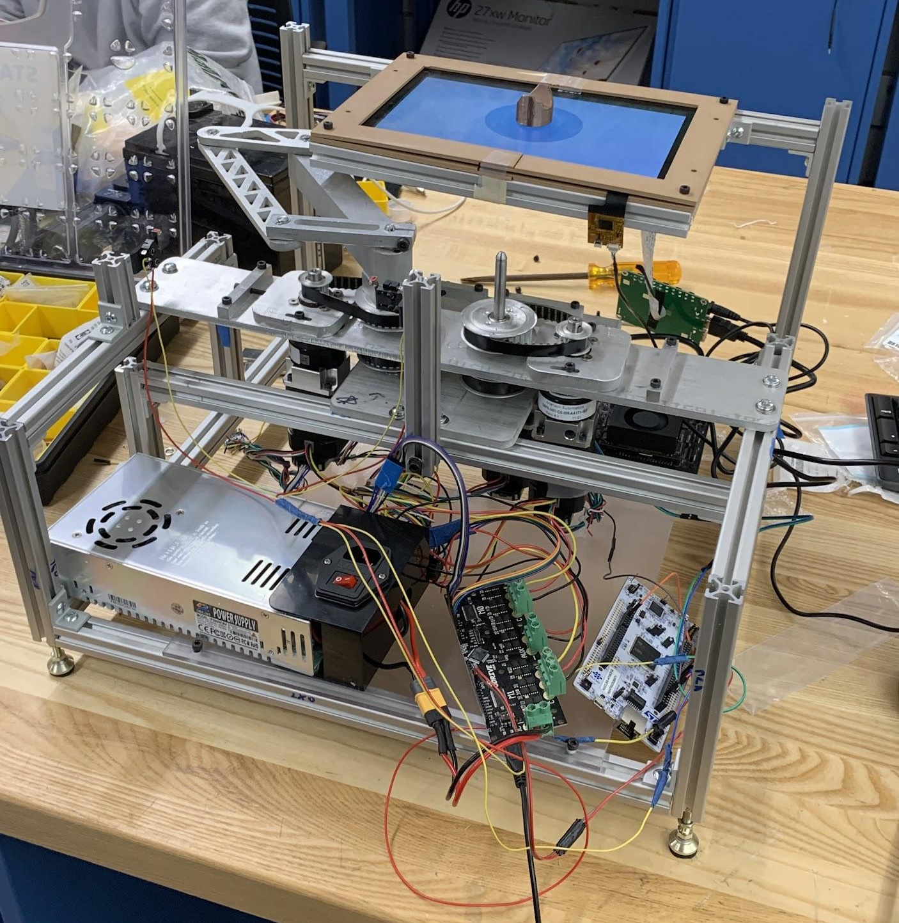
Alpha Review
Strengths
Strong magnets create stiff walls and high shear force (8N)
Accurate arm kinematics; tracks point well
Weaknesses
Free-motion friction severely dampens user experience (4N)
Poor frame rigidity & wire management
Calibration process is tricky
Exposed arms create pinch points

Slide 5
Tablet Beta - Road Map
Alpha Review
Direct Improvements
Haptic Trade
Design Options
Notes:
Cam

Slide 6
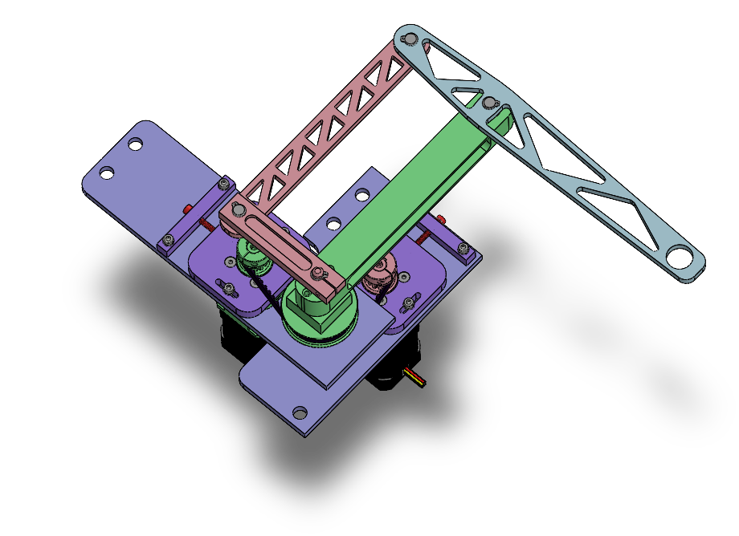
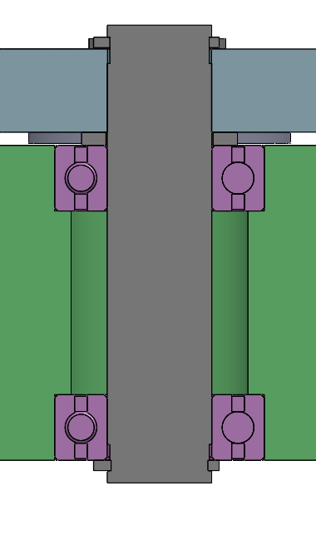
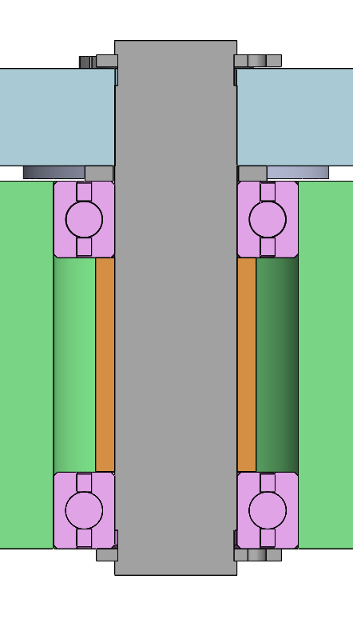
Revision of Base-Distal Axis
Design of base link required machining bearing bores in separate operations. This caused misalignment and a lot of friction.
Revised design allows for bore to machined in one operation, so bearings will be much better aligned.
Alpha
Beta
Distal link
Bearings constrained axially by spacer
Bearings constrained axially by shoulders in base link
Base link

Slide 7
Re-machine Pulleys?
Maybe we want to discuss the re-machining of pulleys so they’re more concentric? Maybe make some soft jaws?

Slide 8
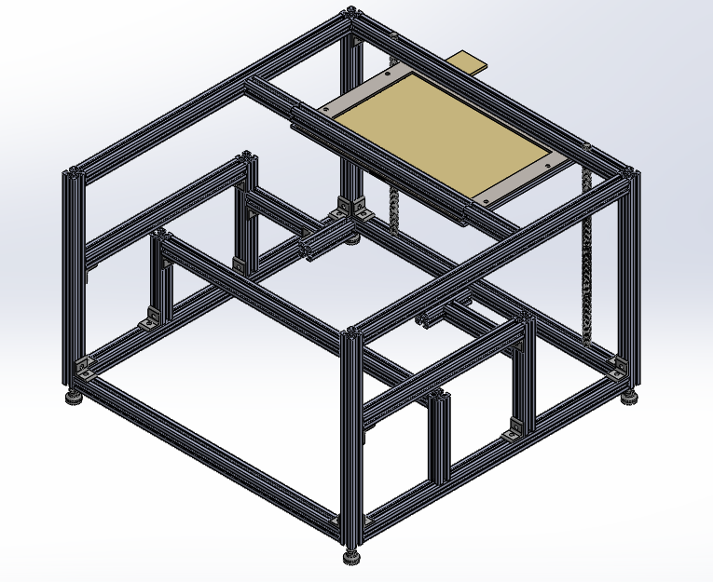
Frame Assembly
Add more 80/20 to improve rigidity
Mount screen below 80/20 vs on top
Re-assemble with square and level
Use gussets where necessary
Add guarding to protect users from pinch points

Slide 9
Guarding/Aesthetics
Add acrylic/metal sheets to protect users from pinch points
Some acrylic or sheet metal plates that act as a skin, also mention that they will act as guards from pinch points

Slide 10
Wire Management
Organize the electronic components on the board
Organize the color of wire by different meaning (GND->Black, 3.3V ->Red, …)
Organize the wire on the board and frame

Slide 11
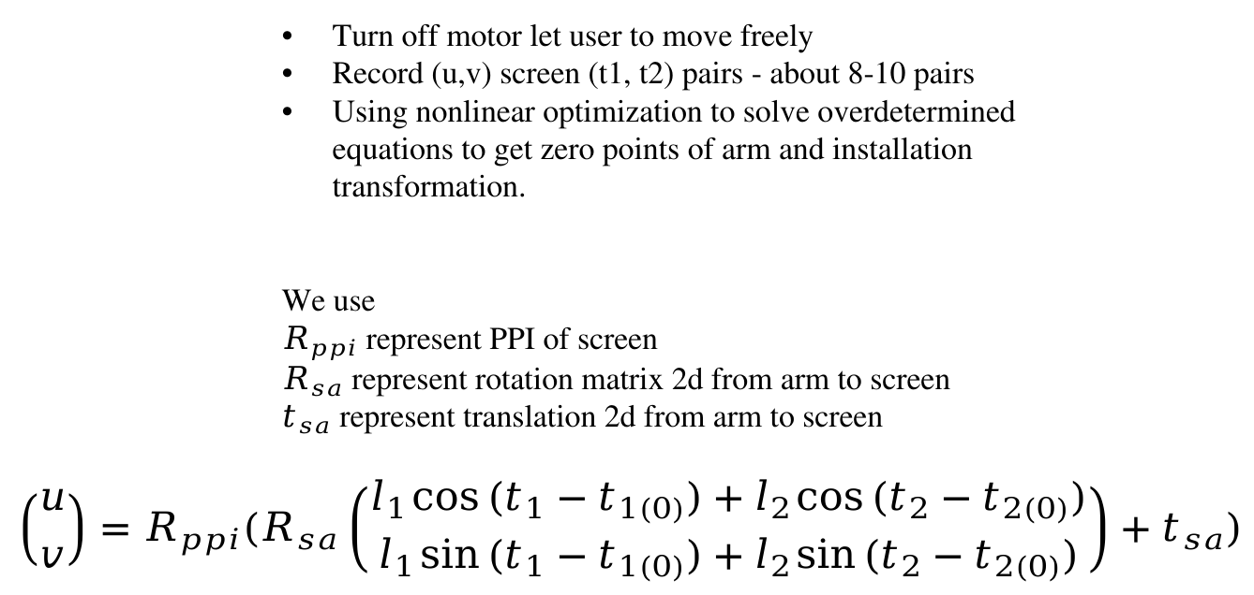
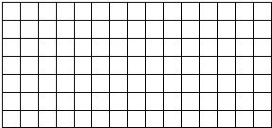
Touchscreen Calibration
Method 2: Optimize with 2R model
Method 1: Grid interpolation

Slide 12
Tablet Beta - Road Map
Alpha Review
Direct Improvements
Haptic Trade
Design Options
Notes:
Cam

Slide 13
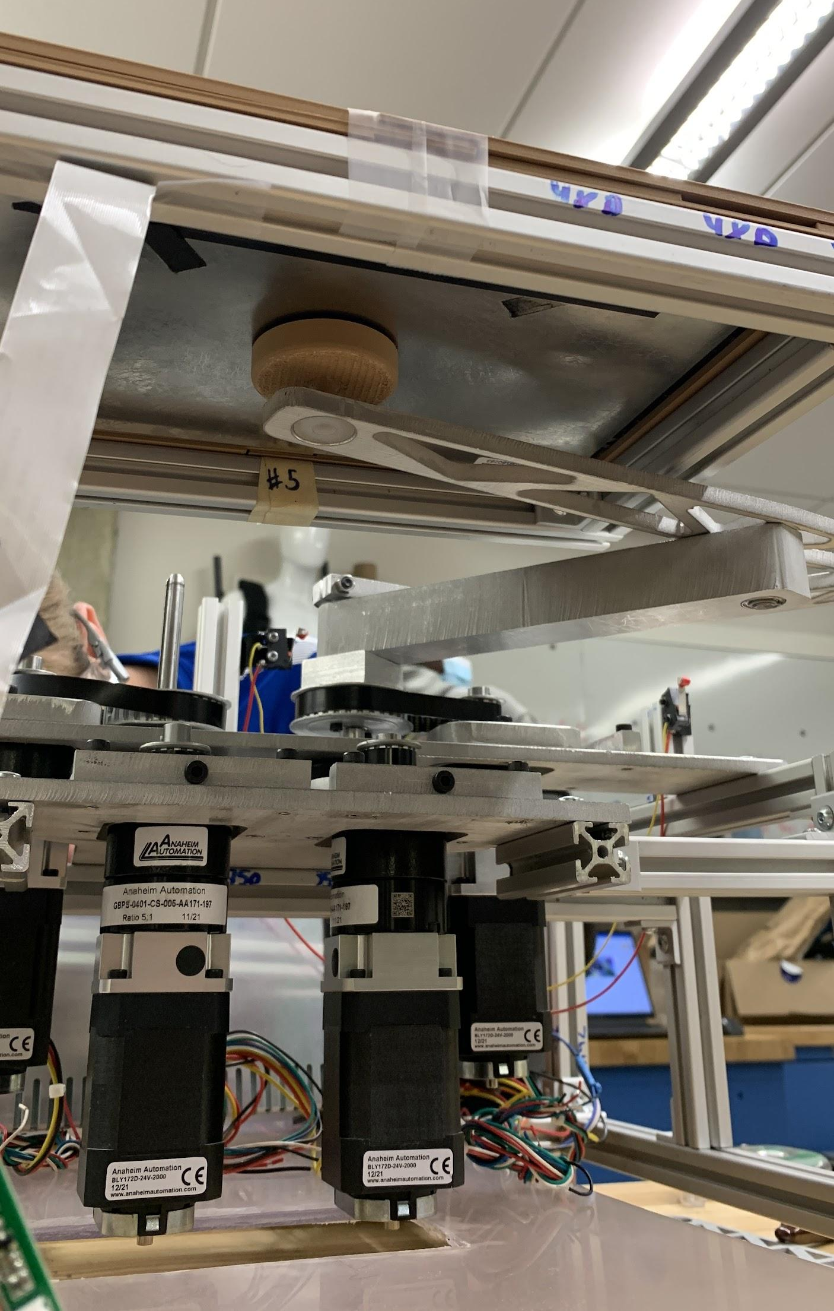
Free-Motion vs. Stiffness
We have not been able to successfully “decouple” the normal and shear force of the magnets via:
Teflon tape
Arrangements of poles (polymagnets)
Air bearings
Thrust bearings
Grease/lubricant
Hence, reanalyze how we weight the importance of free motion vs. stiffness to improve the haptic experience overall.

Slide 14
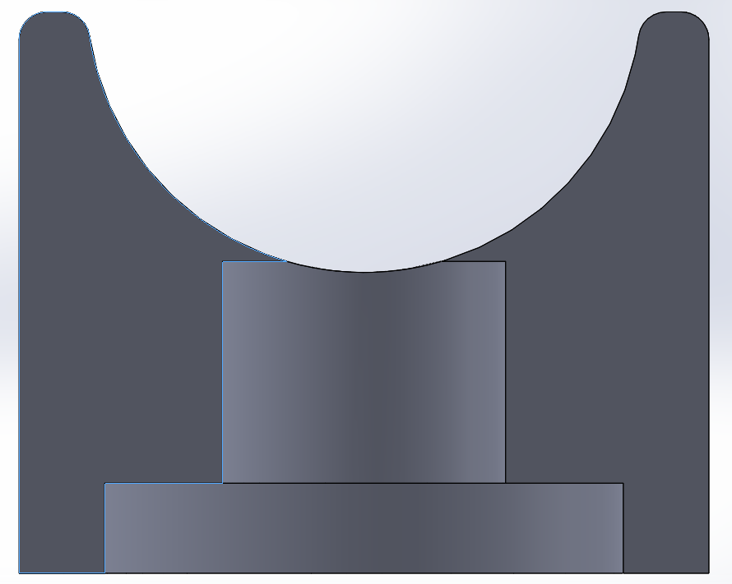
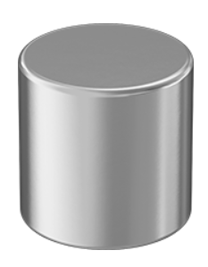
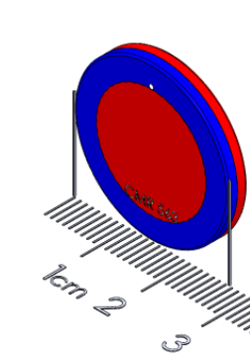
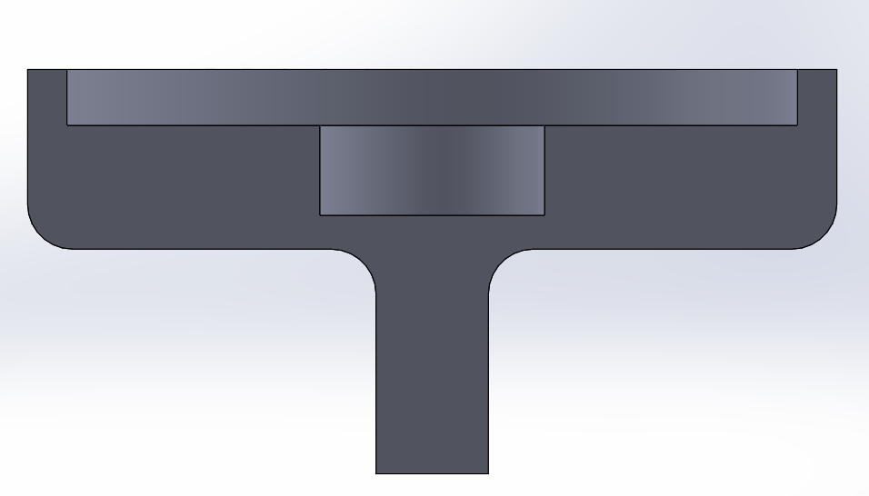
Magnets
The current design uses two different magnets:
Top magnet - ½ inch diameter neodymium magnet from McMaster - pulls 18lbs
Bottom magnet - 1 inch, ⅛ inch polymagnet
Together they give ~8N of shear strength with ~3N of friction
Requirements: >6N of shear strength
This design is providing way too much friction on it’s own - so we will be looking for different alternatives
Notes:
Weaker magnets - there is no need for as much shear strength for the user to experience the haptics
Electromagnets
Delete the magnets

Slide 15
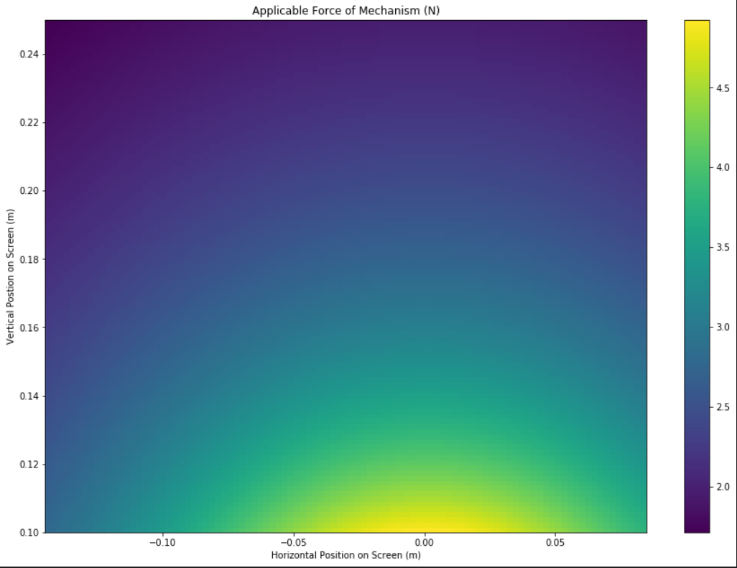
Gearboxes
Weaker magnets allow for a weaker end effector and lesser torque required. Hence, gearboxes could be removed from the drive train.
Pros
No backlash
Reduced reflected inertia & friction
Re-gain budget
Cons
Less force at end effector (1.7 N)
Necessitates transmission changes

Slide 16
Tablet Beta - Road Map
Alpha Review
Direct Improvements
Haptic Trade
Design Options
Notes:
Cam

Slide 17
Option 1: Non-holonomic Repulsion
R
Pros
Much improved free-motion friction
Maintain stiffness of walls
Modular design will allow for rapid prototype
Potential to use two arms with a single puck for multiple force vectors on the user
Cons
User is pushed away/up from screen
Unique control logic; added complexity to changing force vectors quickly
U
R

Slide 18
Option 2: Electromagnet
Pros:
Can turn off for nearly perfect free motion
Can get high wall stiffness when we need it
Can tune the magnetic attraction force
Cons:
Additional degree of freedom
High friction at wall makes it difficult for the user to pull away

Slide 19
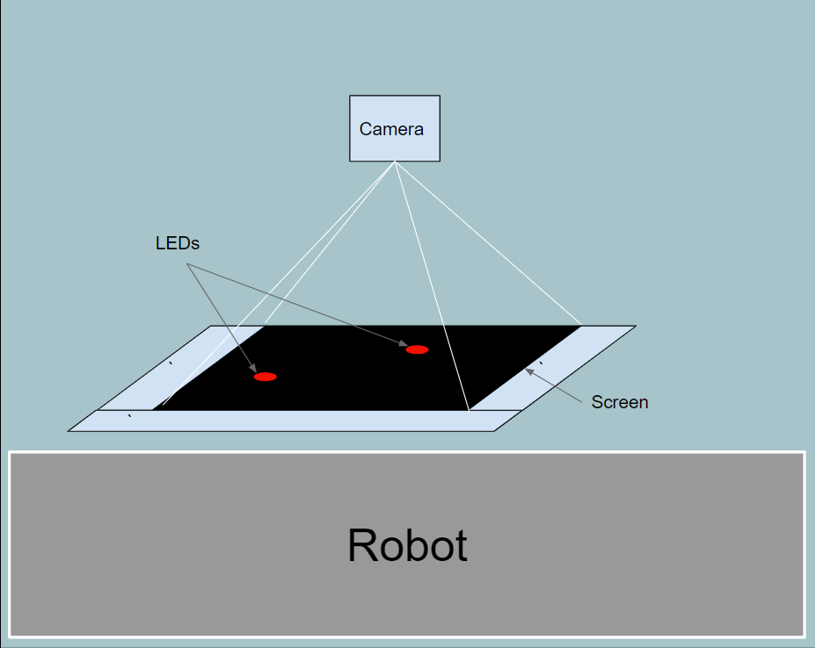
Option 3: Machine Vision
Use camera to track the fingers instead of the touch screen. Likely an LED on the puck.
Pros:
Multi-finger tracking
Existing libraries cut needed work down
Cons:
Additional system to develop and integrate
Does not solve
Notes:
With a powerful enough computer can possibly get >50 Hz tracking frequency

Slide 20
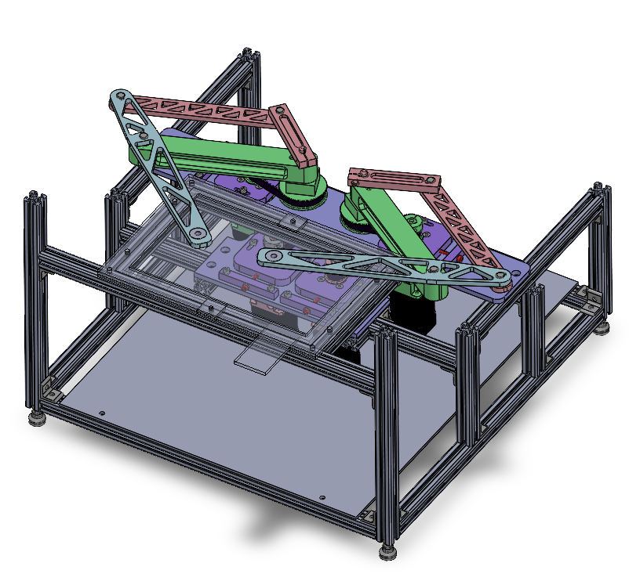

Option 4: Delete Magnets
If there is no solution with magnets that provides sufficient free-motion and stiff-wall haptic quality, remove the magnets entirely from the design and have the device mechanically move the user.
Pros
No magnets
Cons
Diminished user experience
Poor haptics in the phantom linkage itself

Slide 21
Plan Going Forward
Going to prototype two leading options within the next week, and then make a decision about which one we will use for the final demo
Option #1: Weak Magnet
Prototype plan: make new magnet pucks, and then have the robot move in a circle, pulling the user around. See how it feels.
Option #2: Non-holonomic control
Prototype plan: make special bottom magnet puck that holds two magnets, then have the robot always try to be at the closest point to the user on the perimeter of a circle.

Slide 22
Timeline & Allocation
 | Week 7 | Week 8 | Week 9
Jose | Re-assemble Frame with new design | Design and make final magnet pucks | Assist with integration
Diogu | Weak magnet and non-hol prototypes | Design and make final magnet pucks | Assist with integration
Sam | Re-machine base links | Re-make components if nec. | Assist with integration
Cam | Help Jose and Diogu | Re-make components if nec. | Assist with integration
Ray | Place electronic components on board, cleanup wiring | Continue cleanup, help Lio as needed | Assist with integration
Lio | Work on calibration | Work on demo software | Integrate code with system
Team | Prototype magnet options | Finalize mechanical components | Integrate for final demo

Slide 23
Planned Demos
Circular Stiff Wall
Previously demonstrated, user is “constrained” within a circular boundary
???
Depends on which direction we go based on prototypes. Some random ideas
Object cross-section visualization
Angry birds

